Slide 1
Set and Map

Slide 2
Set
Set is a collection of unique objects ,ignores duplicates
Set types also allow basic operations like adding /,removing/ accessing / iterating objects
It does not maintain index
There are three implementations
HashSet , TreeSet, LinkedHashSet.
It is implicitly a map

Slide 3
List vs Set
Allows duplicate element
Any number of null
It is an ordered collection
Allows only unique elements
Only one null
It is dependent on the implementation type

Slide 4
HashSet
HashSet
Uses hashing algorithm to store/retrieval of elements in the collection
It is not ordered and sorted
It ignores duplicates
Wrapper and String duplicates types are eliminated based on content and also obj ref
UDT are eliminated based on overridden equals() and hashcode()
It is fastest among set

Slide 5
Hashset is implicitly a map
Array of singular linked list
set.add(“Aa”)
Firstly determines hashcode for element
For the Hashcode, if there is no bucket found,
Allot the bucket and then stores it
For the Hashcode, If bucket is found
It checks for uniqueness based on equals()
If equals() returns false, then it will add in to set

Slide 6
Set.remove(“BB”);
Firstly determines the hash code
If the hash code presents, then it will only search in that bucket
In each bucket, try to have only one data/ minimum data

Slide 7
Hashcode contract equals
If two hashcodes are equal, then objects may or may not equal
It two objects are equal, then hashcodes must be equal

Slide 8
Set.add(“Aa”);
Set.add(“BB”);
Set.add(“BE”);
Set.remove(“BB”)
Hashcode
65 * 31 ^1 + 97 * 31 ^ 0 = 2112
66 * 31 ^1 + 66 * 31 ^ 0 = 2112
66 * 31 ^ 1 + 69 * 31 ^0 = 2115
2112
2115
Aa
BB
BE
Initial capacity of Hashset is 16
Load capacity = 0.75f

Slide 9
HashSet-Constructor
Set s = new HashSet();
Set s = new HashSet(ic);
Set s = new HashSet(ic, loadfac);
By default initial capacity(ic) is 16 and load factor is 0.75
Load factor determines when to grow hashset
When 75% is filled in the set, it will start growing
Newcapacity = Oldcapcity * loadfactor

Slide 10
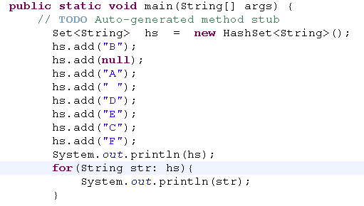
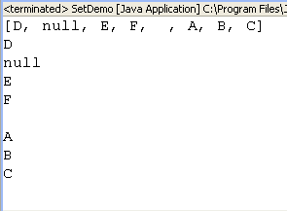
Set – Hash set(String/wrapper)
No ordered, no sorted
It adds unique items
It adds null

Slide 11
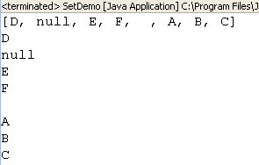
Unique elements
hs.add("B");
hs.add(null);
hs.add("A");
hs.add(" ");
hs.add("D");
hs.add("E");
hs.add("C");
hs.add("F");
hs.add("A");
No err is displayed
It ignores
Only first object is kept

Slide 12
HashSet
If userdefined instance are kept in the set
It eliminates duplicates based on the obj ref
If you want to eliminate duplicates based on the content
Override hashcode() and equals()
Set.add(car)
Firstly determines the hash code by invoking overriden hashcode()
If hashcode is already present, then it will go and check in that bucket, using equals()
If equals() returns false, It will add in to the set

Slide 13
LinkedHashSet
It is ordered not sorted
Elements are retrieved based on insertion order
It also uses hashing algorithm for add/retrieval
It is slower than HashSet but faster than TreeSet

Slide 14
Eliminate duplicates for HashSet/LHS
How HashSet eliminates duplicates if it contains user defined instances.
It eliminates duplicates based on hashCode() and equals()

Slide 15
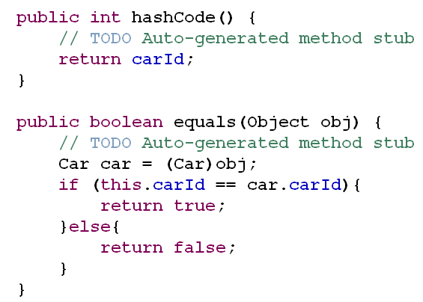
Override equals and hashcode
Class Car{
private int carId;
private String crName;
private double carPrice;
…….
……
//override equals and hashcode
}

Slide 16
Which set is used for sorting
Treeset

Slide 17
TreeSet
It is a sorted set
It is costlier because it fires sort algorithm whenever element is added/removed
Either the element must implement Comparable interface or pass comparator instance in treeset constructor

Slide 18
TreeSet
Treeset is not effeciency for adding and removing
Effeciency for traversing

Slide 19
TreeSet - constructor
Set s = new TreeSet()
Sorts comparable elements
Set s = new TreeSet(Collection)
Copies collection to treeset and sorts based on comparable elements
Set s = new TreeSet(Comparator)
Sorts based on Comparator

Slide 20
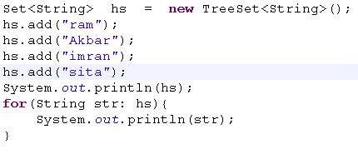
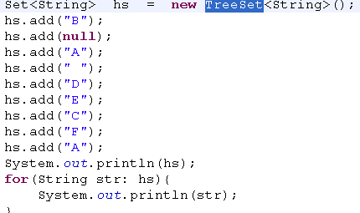
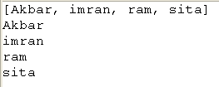

TreeSet
All the type must be same
It is ordered, sorted
Treeset cannot sort null

Slide 21
Map
Map is a collection of key and value paired element
There are four types of Map implementations they are HashMap, Hashtable, and TreeMap, LinkedHashMap.
Treemap is slower than other map
When we will go for Map?
To retrieve an element based on the key
Keys must be unique
Hashmap, Linkedhashmap
Only one null key

Slide 22
Hash Map
Hashmap are not ordered, not sorted
Uses hashing algorithm
Allows one null key
Good performance

Slide 23
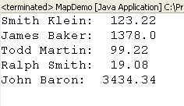
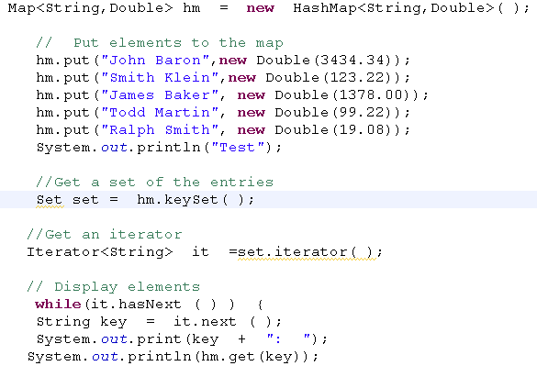
Traversing HashMap
Get all the keys in a set
Keys must be unique
Iterate the keyset
Get the key
Using key get values

Slide 24
Iterating Map
Iterate map
Map.keySet()
Get all the keys from map in a SET
Iterate set
Pass each element in a set to map.get()
Map.values()
Get all the values from the map in a collection
Iterate the collection that holds only values of map

Slide 25
HashMap vs HashTable
HashTable methods are synchornized.
HashTable does not allow null element
HashMap methods are not synchronized
Allows null element

Slide 26
LinkedHashMap
It retrieves based on the insertion order of keys

Slide 27
TreeMap
It sorts the elements based on key
If key is null, Compliles fine but Runtime exception.
Treemap is costlier.
It sorts based on comparable element or pass comparator instance to TreeMap constructor
All the keys must belong to same type

Slide 28
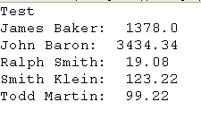
TreeMap
Map<String,Double> hm = new TreeMap<String,Double>( );
Keys are sorted
All key types must be same

Slide 29
Collection | Ordered | Sorted
Any type of list | y | n
HashSet | n | n
LinkedHashSet | y | n
TreeSet | y | y
HashMap and HashTable | n | n
TreeMap | y | Y
LinkedHashMap | y | n

